Slide 1
Predict the Unit Sales of Walmart Retail Foods
Arezoo Memarian

Slide 2
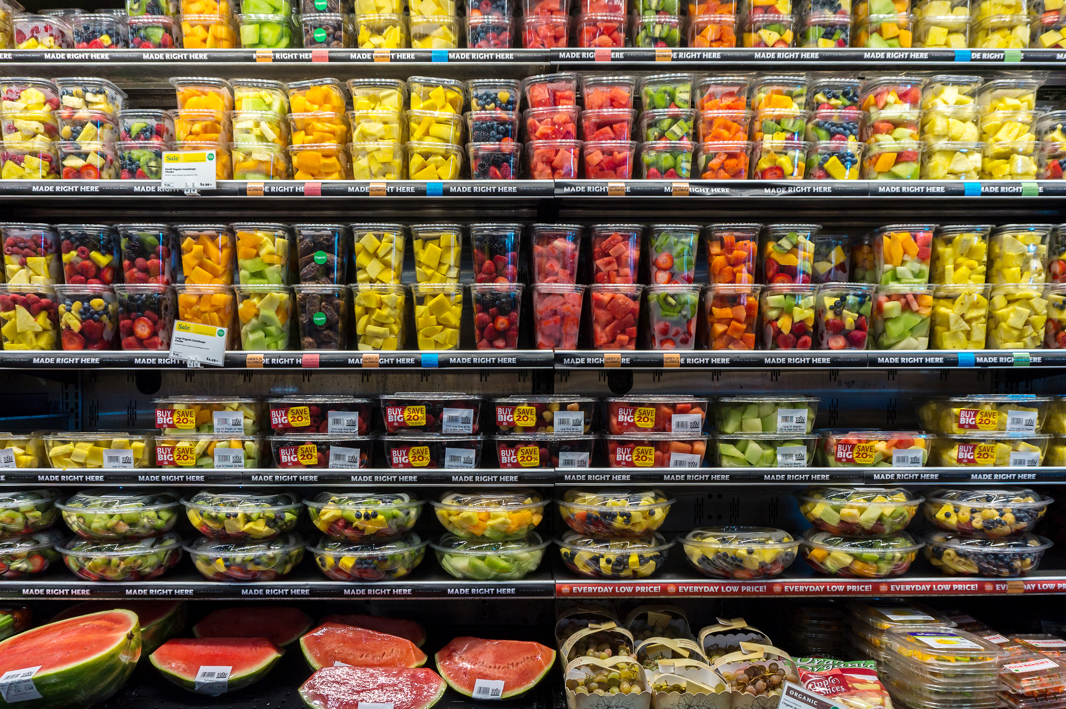
Problem statement
Walmart aims to predict daily sales of ten food items in California, Texas, and Wisconsin stores.
Precise sales forecasts are crucial for:
maintaining optimal inventory levels
preventing stockouts or
overstocking
The dataset covers 1913 days from 2011 to 2016, with a focus on forecasting daily sales for the next 28 days.

Slide 3
Data Information
Data source: Kaggle
Datasets:
Calendar: Dates on which the products are sold (2011-2016).
Sell prices: price of the products sold per store and date.
Sales-training: Historical daily unit sales data per product and store for day-1 to day-1913.
Sales-All: Sales data for day-1 to day-1941 (contains the next 28 days).
Data Organization:
Merged all the datasets
Ordered by week (temporal nature)
Total features: 13

Slide 4
Data Cleaning
Check for Missing Values:
Identified missing values in 'sell_price', 'event_type', and 'event_name' columns
Filled null values in :
'event_type' and 'event_name’ columns with 'None' to indicate no event
'sell_price' by filling with the mean of each year for each item at each store

Slide 5

Exploratory Data Analysis
Individual Feature Distributions
Exploring Sales Distribution

Slide 6
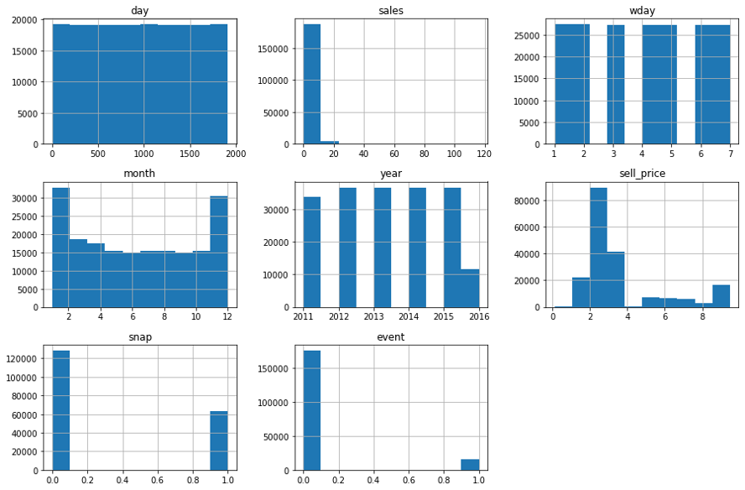
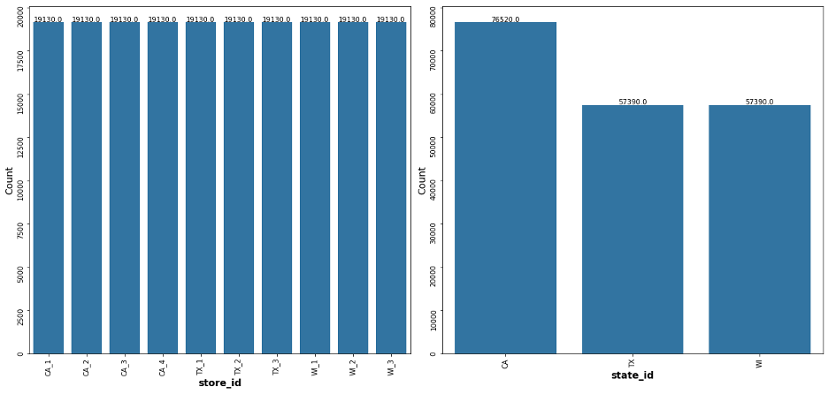
Individual Feature Distributions
Most Features Appears Sensible
Sales distribution:
Concentration of sales in lower quantities (99.6% of all sales fall below 25 units)
Food item 4 stands out with sales exceeding 35 units
All other food items have sales below the 35-unit

Slide 7
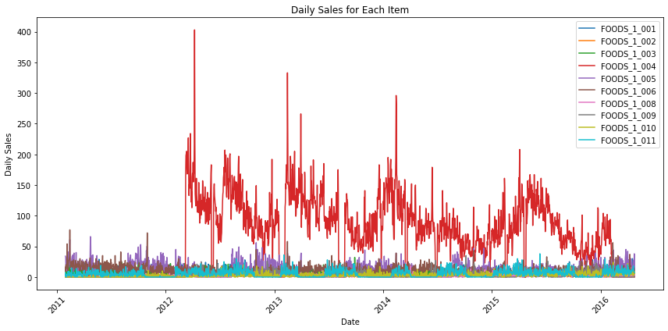
Daily Sales
Food item 4 has a significantly higher number of sales compared to others
Sales of food items 4,8, and 9 begin in the year 2012
Food items 1 and 5 experienced periods with zero sales

Slide 8
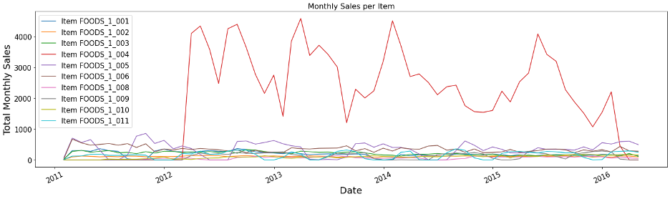
Monthly Sales
Fluctuations in sales volumes without a consistent seasonal pattern
Variable sales trends throughout the year across the items

Slide 9
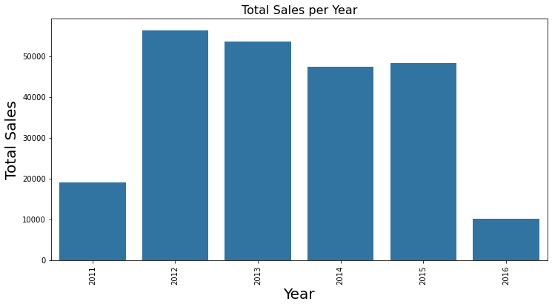
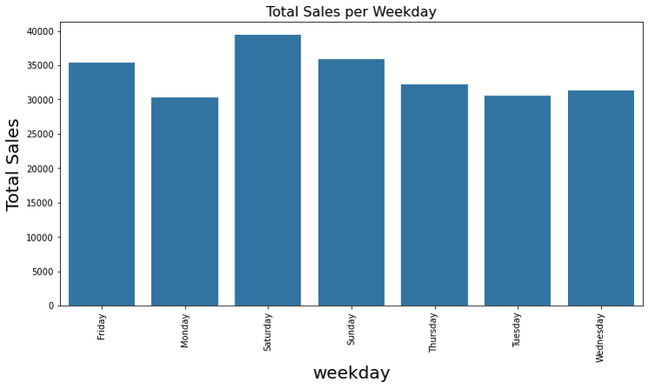
Sales per Year and Weekday
Years 2012 and 2013 have the highest number of sales
Saturday has the highest number of sales

Slide 10
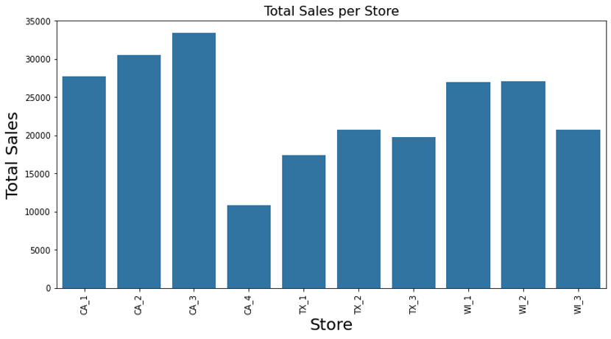
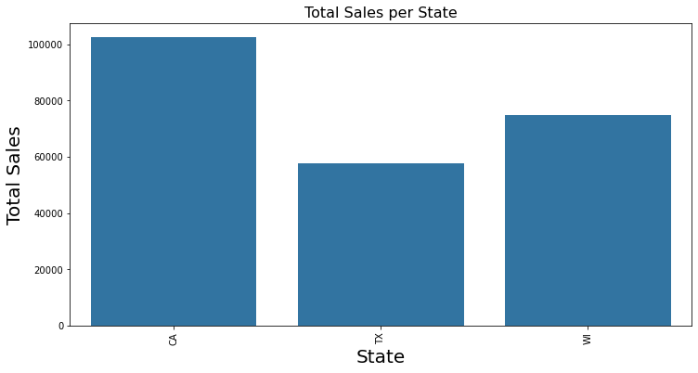
Sales per Store and State
California (CA): CA_3 has the highest sales, while CA_4 has the lowest sales
Texas (TX): TX_2 has the maximum sales, whereas TX_1 with the least sales
Wisconsin (WI): WI_2 leads with the maximum sales, while WI_3 has the lowest sales
US: Stores CA_3 and CA_2 have the highest overall sales, while CA_4 has the lowest number of items sold
California has the highest number of sales among states

Slide 11
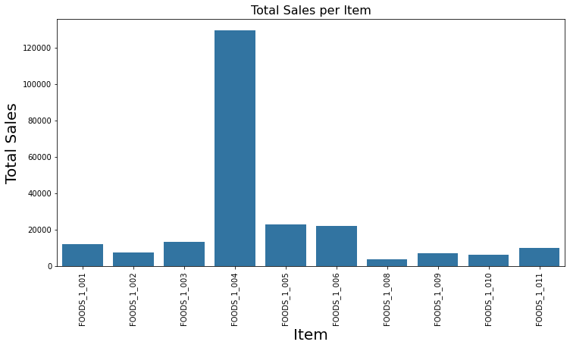
Sales per Item
Food item 4 exhibits the highest sales volume across all stores and dates, totaling more than 120,000 sales overall

Slide 12
Modeling
Data Processing
Decomposition
Model selection

Slide 13
Data Preprocessing
Sequential split for training and testing sets to preserve temporal order

Slide 14
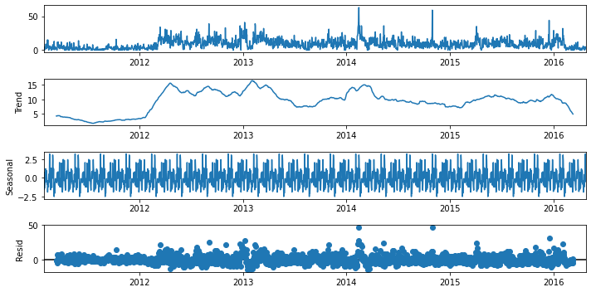
Decomposition
Original Sales (Top Plot): Shows an increasing trend post-2012 due to new item availability and a consistent upward trend over the years. Seasonal spikes are noticeable, especially at the beginning of each year.
Trend Component (Second Plot): Displays the smoothed-out long-term movement, indicating an upward trend, particularly noticeable post-2012.
Seasonal Component (Third Plot): Captures recurring patterns within each year, highlighting seasonal spikes and dips.
Residual Component (Bottom Plot): Represents random fluctuations and irregularities not explained by trend or seasonality.

Slide 15
Model Selection
Timeseries models:
ARIMA
SARIMA
ARIMAX
Prophet

Slide 16
Model Comparisons/Model Performance
Models | RMSE | AIC
ARIMA | 5.12 | 11,875
SARIMA | 7.86 | 13,321
ARIMAX | 6.05 | 11,855
Prophet | 6.31 | -

Slide 17
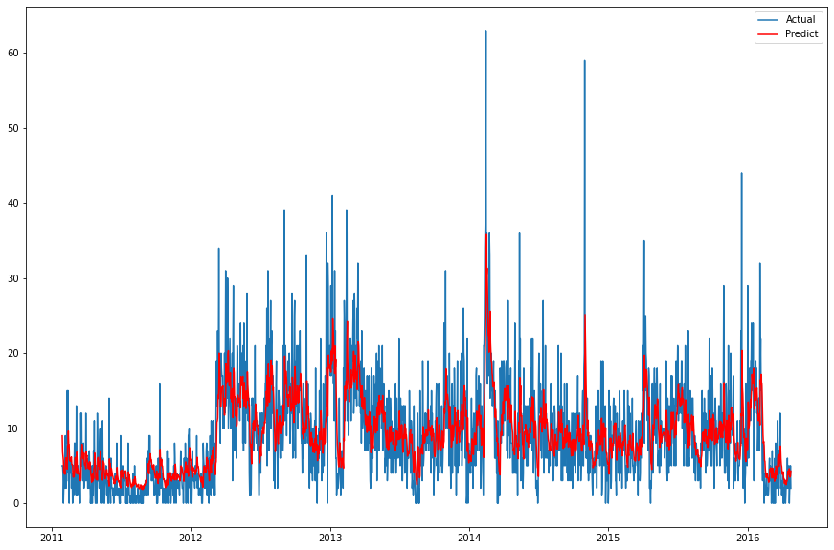
ARIMA Model
RMSE: 5.1
AIC: 11,875
BIC: 11,903

Slide 18
Remarks
Developed advanced timeseries models to create accurate order forecasts.
Significant business implications, including optimized procurement strategies, and targeted operational decisions to enhance sales and customer satisfaction.

Slide 19
Future Direction
Feature Engineering:
Incorporate additional features such as promotional events, seasonal trends, and competitor pricing to capture more comprehensive factors influencing sales variability.
Ensemble Modeling:
Explore ensemble techniques that combine the strengths of multiple models (e.g., ARIMA, SARIMA, and Prophet) to leverage their collective predictive power and mitigate individual model weaknesses.
Machine Learning Algorithms:
Explore advanced machine learning algorithms like Gradient Boosting Machines (GBM), Long Short-Term Memory (LSTM) networks, or neural networks to capture complex temporal patterns.

Slide 20
Thank you!

